Slide 1
Tutorial Ninja
Project Created By:- Poulomi Roy (fs39_330518)

Slide 2
Contents
Feature Overview
Approach to testing
Key findings( Bugs, Test Cases)
Screenshot from Jira
Suggestion for Improvement

Slide 3
Feature Overview
Feature Assigned:- User Registration Currency
1.User Registration Feature:-
Allows users to create an account for personalized shopping.
Requires basic details like name, email, phone number, and password.
Provides a secure login system for returning users.
Enables features like order tracking, wishlist management, and faster checkout.

Slide 4
Feature Overview
2.Currency Feature:- Users can select their preferred currency for product pricing.
Supports multiple currencies for international shoppers.
Automatically updates prices based on the selected currency.
Enhances user experience by providing localized pricing.

Slide 5
Approach To Testing:-
1.Test Plan Creation:-
Outline the testing scope and objectives including responsiveness,validation.
Identified key feature to test , including user registration and currency.
2.Test Case design:-
Developed detailed test cases for each feature focusing on functionality , responsiveness and user interaction.
Test case for User Registration and currency feature. Example:-checking the valid and invalid mail id and Currency feature is changing or not as per our selection.

Slide 6
Approach to testing:-
3.Execution of Test Cases:-
Performed functional testing to verify user registration and currency selection behaviour.
Validated user registration by testing different inputs (valid, invalid email formats, empty fields).
Checked currency selection feature to ensure price updates correctly based on the chosen currency.
Tested responsiveness across different screen sizes (desktop, mobile).
Performed cross-browser testing to check compatibility(Chrome, Safari.)
Logged defects and issues found during testing and documented results for review.
4.Bug reporting:-
Identified and documented defects found during test case execution.
Categorized bugs based on severity (Critical, High, Medium, Low).
Logged issues in a tracking tool (JIRA) with proper descriptions
Provided steps to reproduce for better understanding and quicker resolution

Slide 7
Key Findings
Verify registration with invalid email format
Verify registration with emoji in username
Verify registration with non-alphanumeric password
Verify registration with spaces in username
Verify registration with excessive white spaces in password
Verify registration with special characters in phone number section
Verify Registration without accepting the privacy policy
Verifying Registration with numeric value in first name section
Verifying Registration with numeric value in last name section
Verify that the currency dropdown is accessible using keyboard

Slide 8
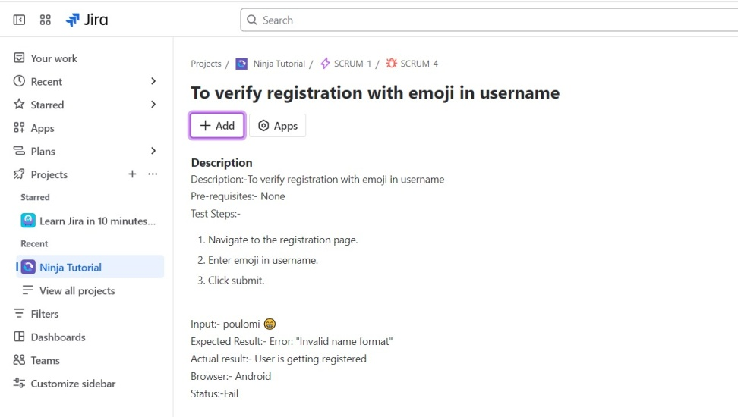
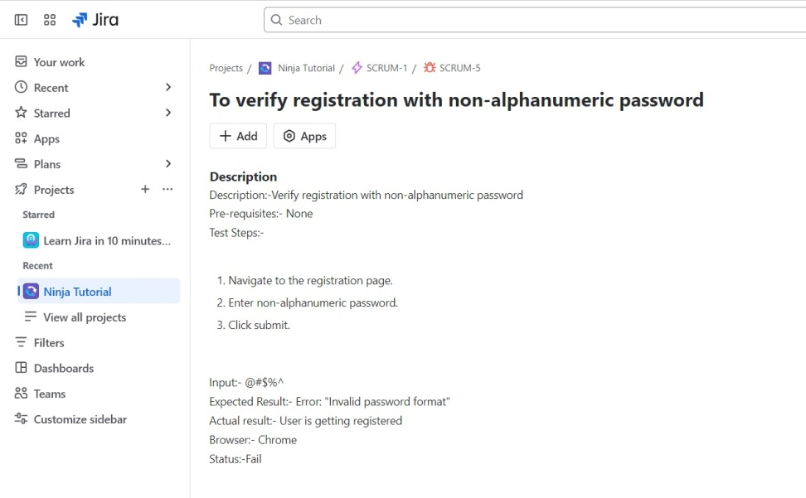
Screenshot from Jira

Slide 9
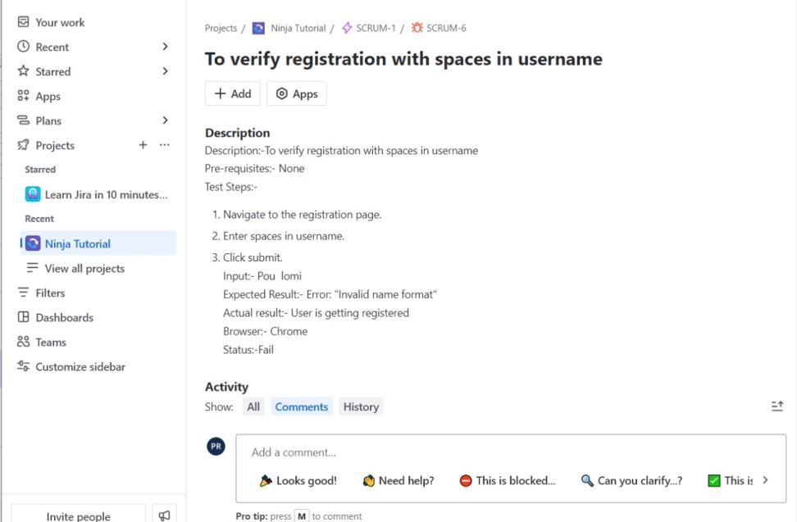
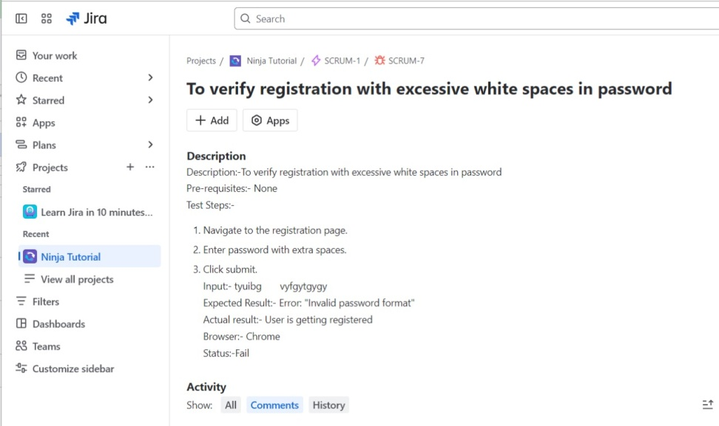
Screenshot from Jira

Slide 10
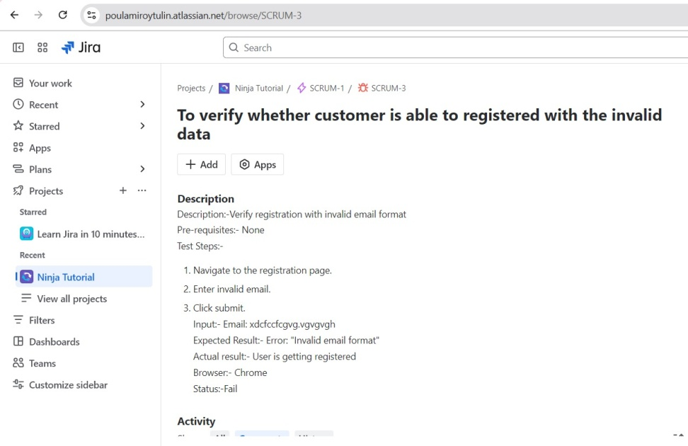
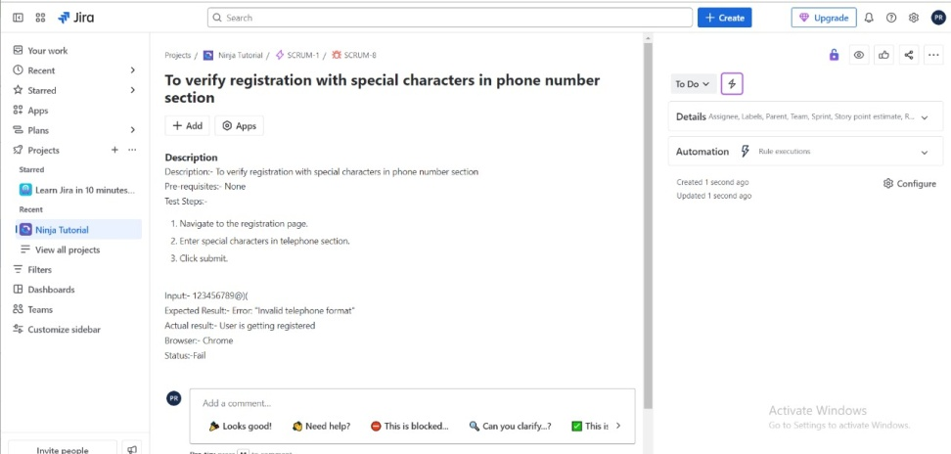
Screenshot from Jira

Slide 11
Suggestions for Improvement:-
Addressing Defects: Immediate attention should be given to resolving the identified critical defect.
Retesting: Ensure failed test cases are retested after the defects have been resolved, with particular focus on functionality and performance.
Further Testing: Expand the scope of testing to cover more edge cases and to assess performance under varying user loads.

